Slide 1
Generating Personalized Emails with GPT-2
Group O: Yun Cao, Yue Liu, Muyang Cheng, Nan Chen

Slide 2
Introduction

Slide 3
Personal Emails Generation
This project aims to create an effective communication tool that can help establish connections on platforms like LinkedIn. We trained a model using GPT-2 to generate personalized emails based on user inputs.
Task: Text Generation
Model: postbot/distilgpt2-emailgen-V2
Dataset: LightTai/personalized-email
Libraries: Transformers, datasets, torch, scikit-learn, accelerate

Slide 4
Main Problem
How to train our model to generate personalized emails?
How to use our model?
How to evaluate our model?
How to avoid misuse of our models and ethical considerations?

Slide 5
Analysis and Findings

Slide 6
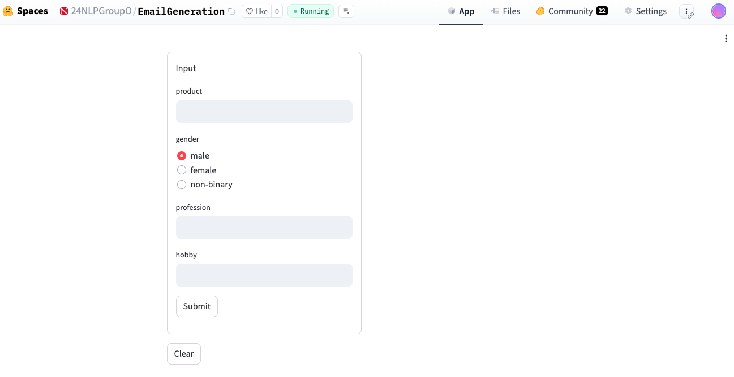
Usage
Start the app

Slide 7
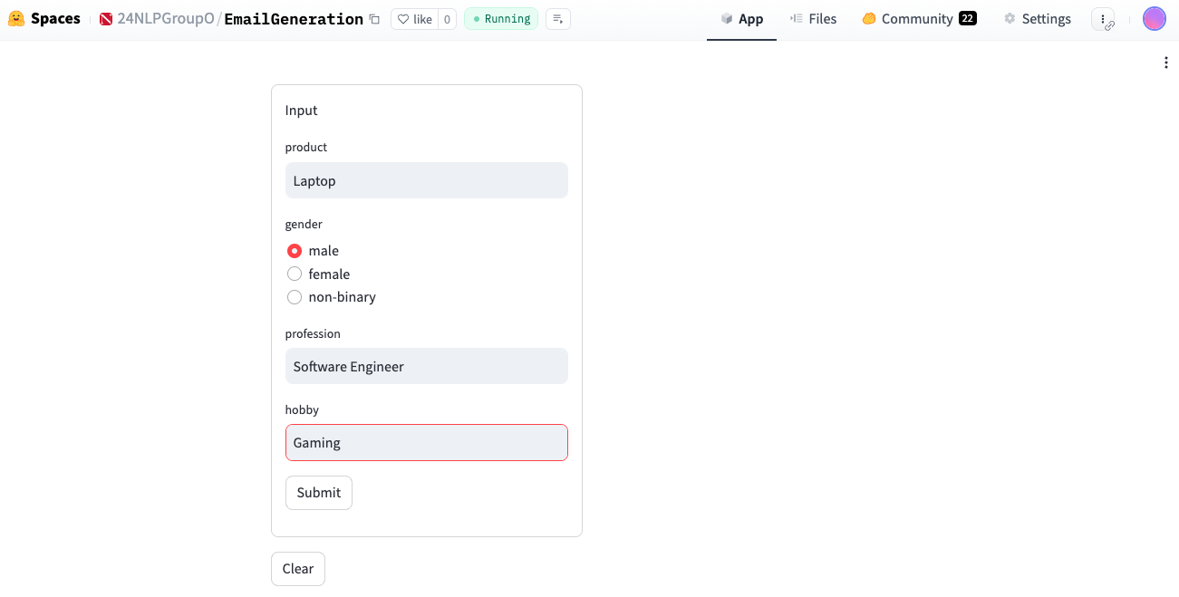
Usage
User input

Slide 8
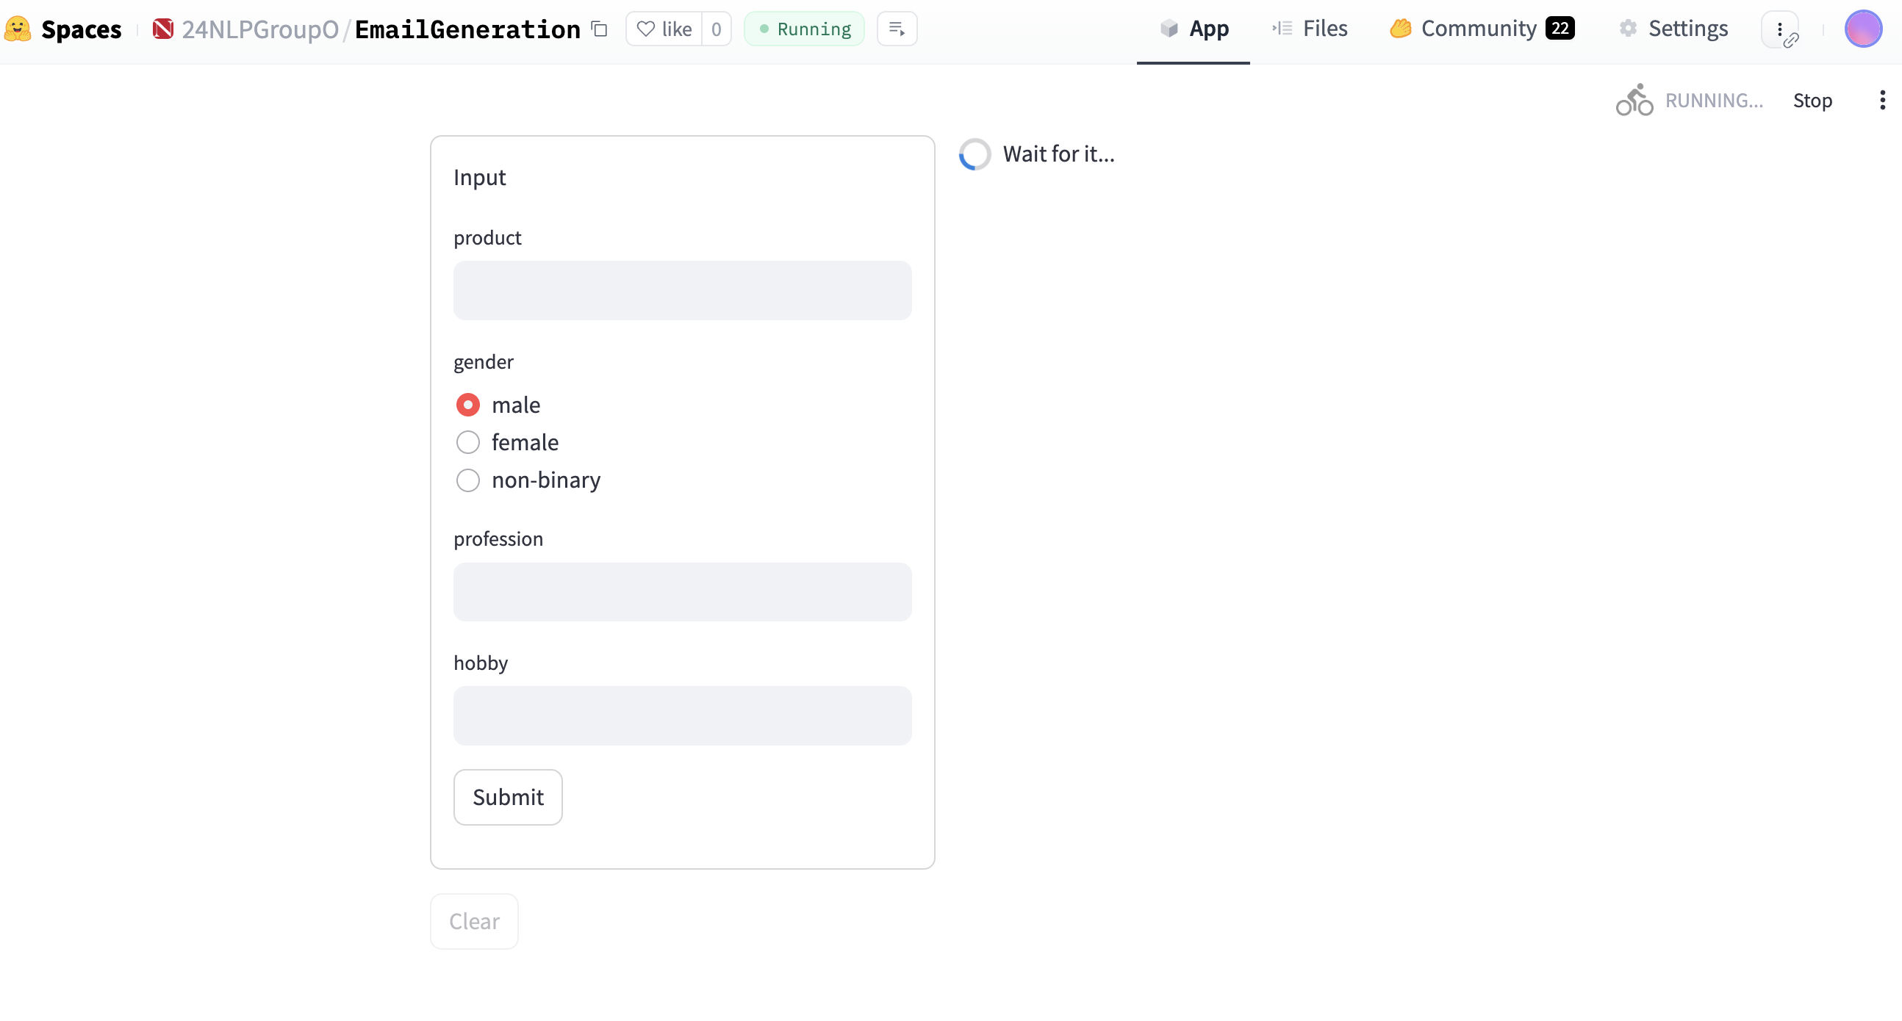
Usage
Wait for minutes

Slide 9
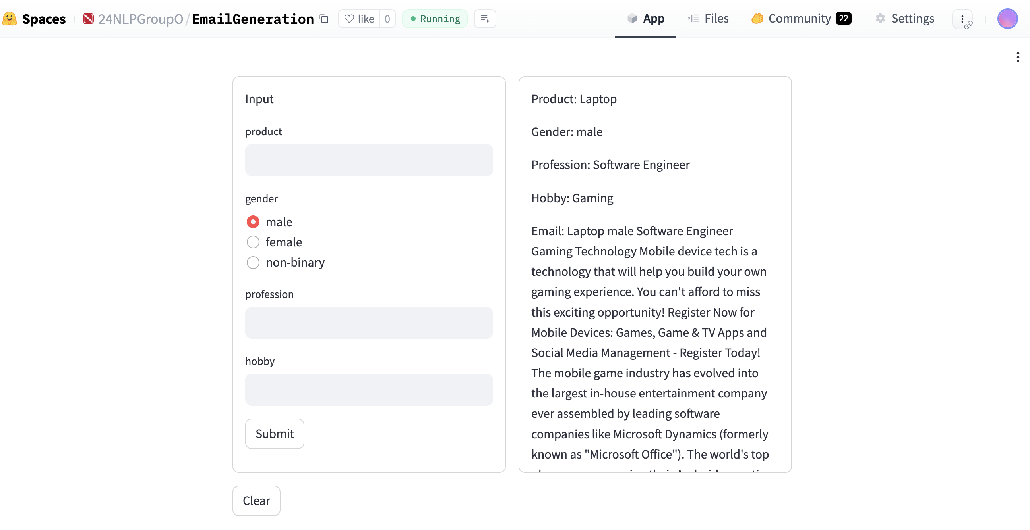
Usage
Output

Slide 10
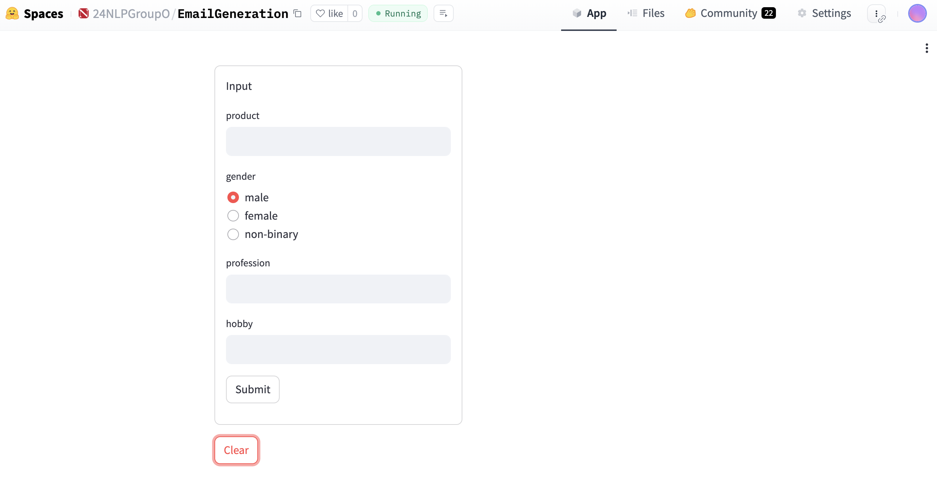
Usage
Clear

Slide 11
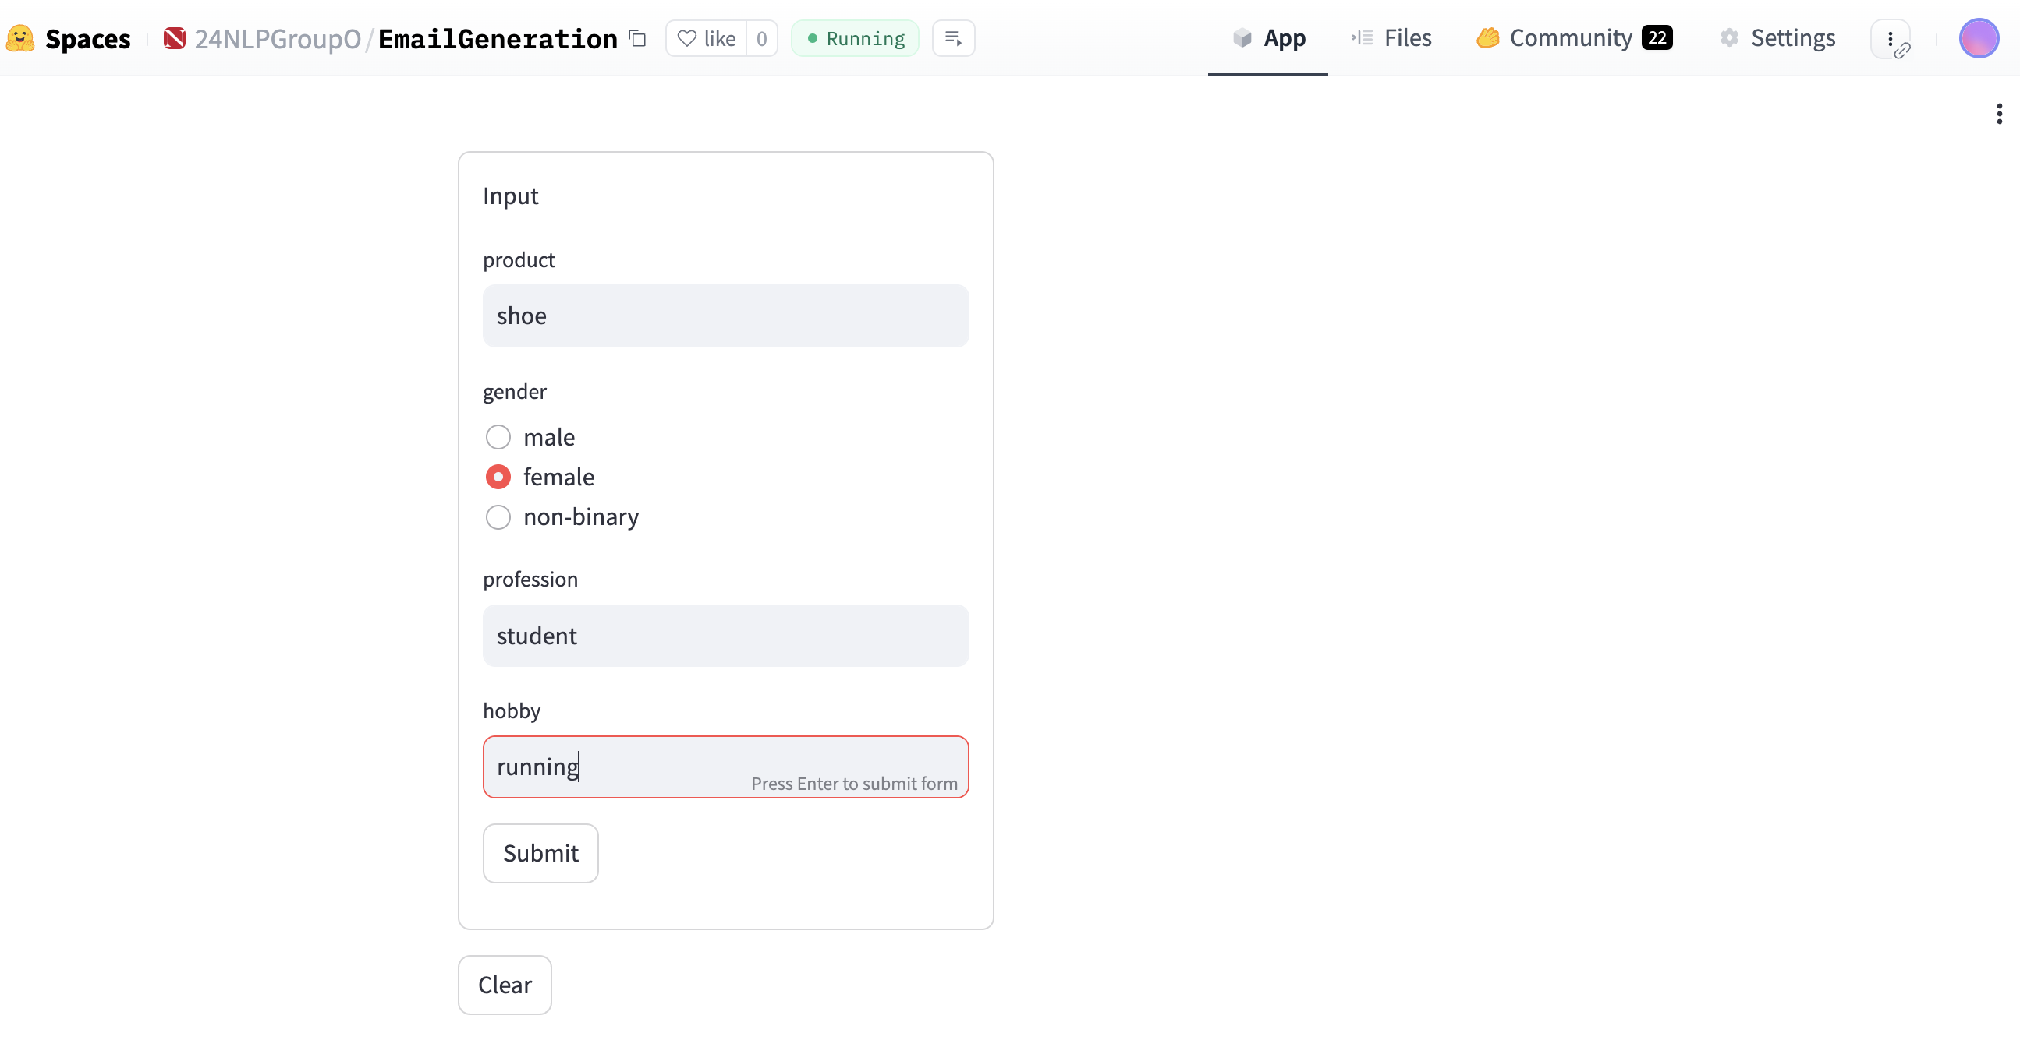
Usage
Retry

Slide 12
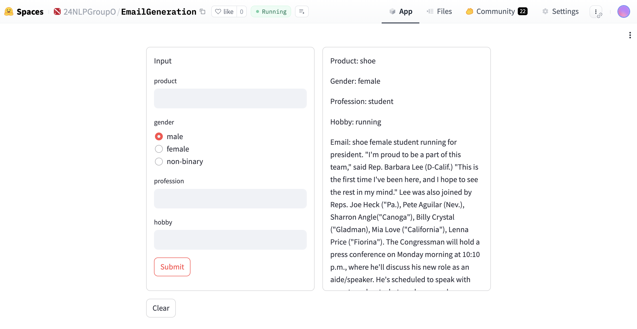
Usage

Slide 13
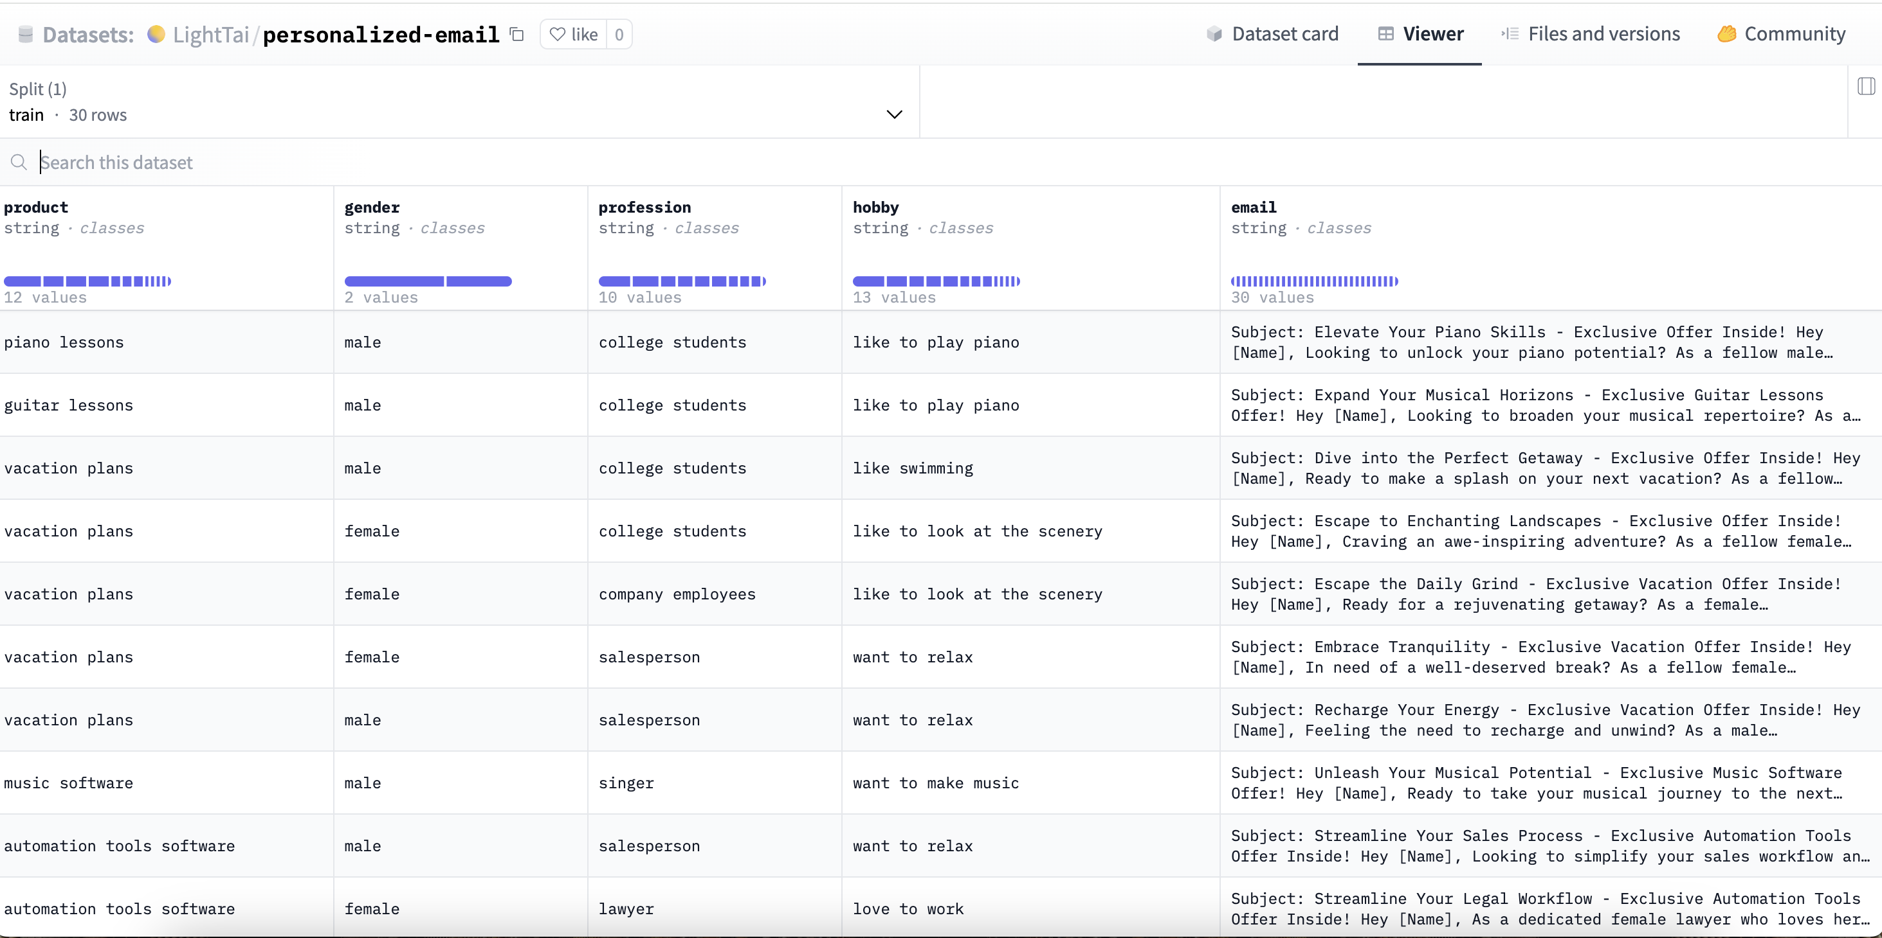
Model
Data Analysis

Slide 14
Model
NLP Methodology and Techniques Employed
Tokenization and Text Processing: Use the AutoTokenizer from the transformers library to tokenize input data, which is crucial for processing text in a format suitable for NLP models.
Dataset Handling: Employs the datasets library to load and manage datasets, converting datasets to Pandas tables for easier handling and then back to the dataset format after preprocessing for training.
Neural Network Modeling: Use AutoModelForCausalLM from the transformers library to load a pretrained causal language model specifically designed for generating sequences of text.
Evaluation Metrics: Implements evaluation metrics using the evaluate library (specifically the rouge metric), which is widely used to assess the quality of text generation against reference texts. This is critical for understanding model performance in generative tasks.

Slide 15
Model
Transfer Dataset to Model Tokenize
Loading Pre-trained Model Tokenizer: An AutoTokenizer is loaded with a specified pre-trained model checkpoint. The tokenizer is a crucial tool that converts text data into a format that can be processed by machine learning models.
Tokenization Function: The tokenize function is defined to tokenize the inputs. It takes examples from the dataset and pulls the product, gender, profession, and hobby columns. These columns are tokenized, meaning they are converted into a sequence of numbers that represent the text in a way the model can understand.
Processing the Dataset: The dataset is split into a training set and a test set with a 50/50 split. The original Data Frame is then converted into a Dataset object, which is a more efficient format for handling datasets in machine learning workflows.
Tokenizing the Dataset: The actual tokenization process happens where the training and test sets are mapped with the tokenize function. This means that all the text data in these datasets is converted into tokens.

Slide 16
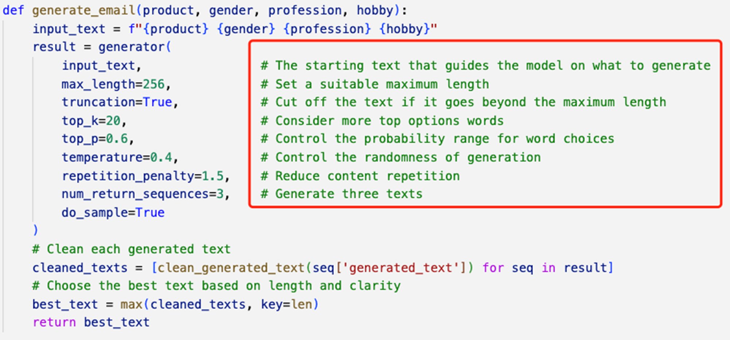
Model
Parameters

Slide 17
Evaluation
BERT Bidirectional Encoder Representations from Transformers
BLEU Bilingual Evaluation Understudy
ROUGE Recall-Oriented Understudy for Gisting Evaluation
 | BERT | BLEU | ROUGE
Target | 1.0 | 1.0 | 1.0
GPT3.5 | 0.843668 | 0.052389 | 0.316623
Translated Twice | 0.96876 | 0.564568 | 0.819048
Title | 0.954038 | 0.000041 | 0.140351
X | 0.774057 | 0.0 | 0.0

Slide 18
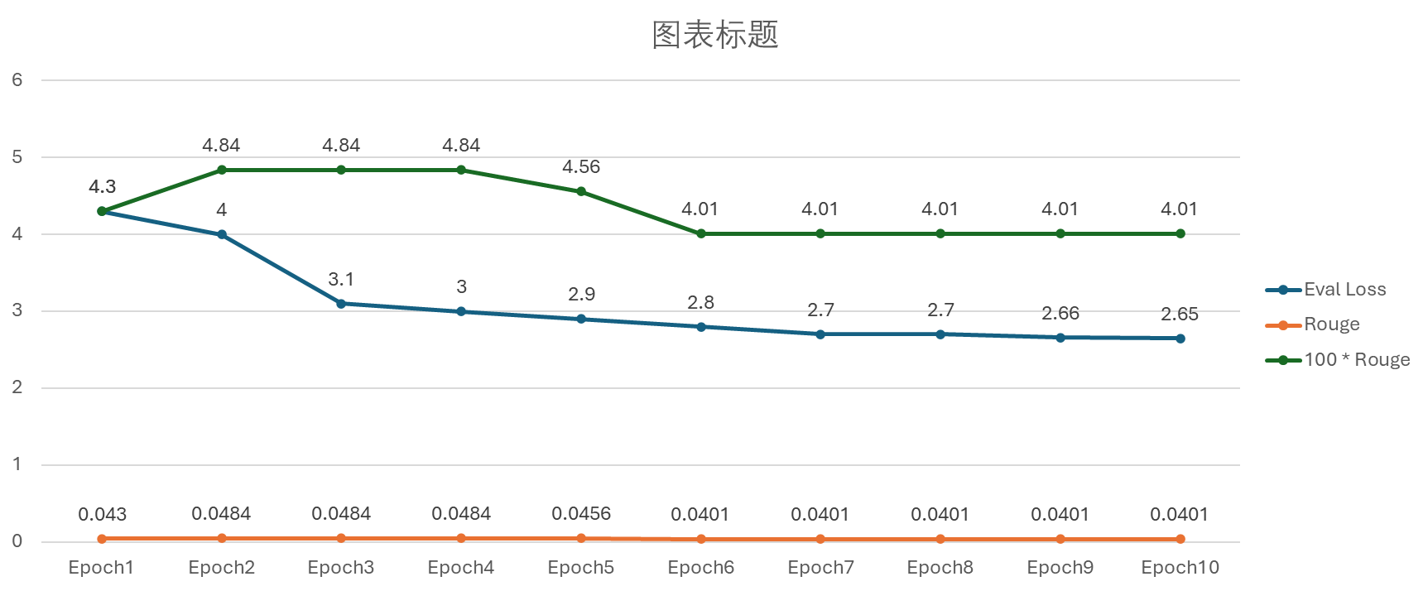
Eval Loss and Rouge Metrics
Evaluation
Final perplexity: 14.17

Slide 19
Limitations and Lessons Learned

Slide 20
Limitation
Model results: The output email is not the email we want to generate. Also, we can’t avoid generating spam or phishing emails. Based on the analysis, it won't improve with continued training. We guess there are two reasons for this:
(1) Limitations of the model itself (2) Limitations of the dataset
Processing Time: The model takes over three minutes to run in the application. This could potentially lead to a less-than-optimal user experience, especially if users are expecting quick results.
Data Formatting: Ensuring the output is well-formatted and easy to understand is crucial for the end-user experience. The generated email does not have a perfect format.

Slide 21
Lesson
The use of hugging face: Understood the process of uploading models and building spaces from scratch on hugging face. Also learned how to work together on hugging face.
The effect of model parameters: Figure out how to add or modify parameters to change the model outputs.
Evaluation model: Understood the effect of different evaluations, and thought about how to choose the right evaluation.
Interactive User Interface: We use Streamlit to create an interactive user interface for the model. It provides a user-friendly way to input data and view the results.
Ethical consideration: We consider the ethical nature of model-generated content. Learned about methods to avoid generating spam and phishing.

Slide 22
Thanks! Q&A

